Slide 1

Museum insights for conservation: A case study with the Jambato harlequin frog, Atelopus ignescens
Chengchen Gao

Slide 2
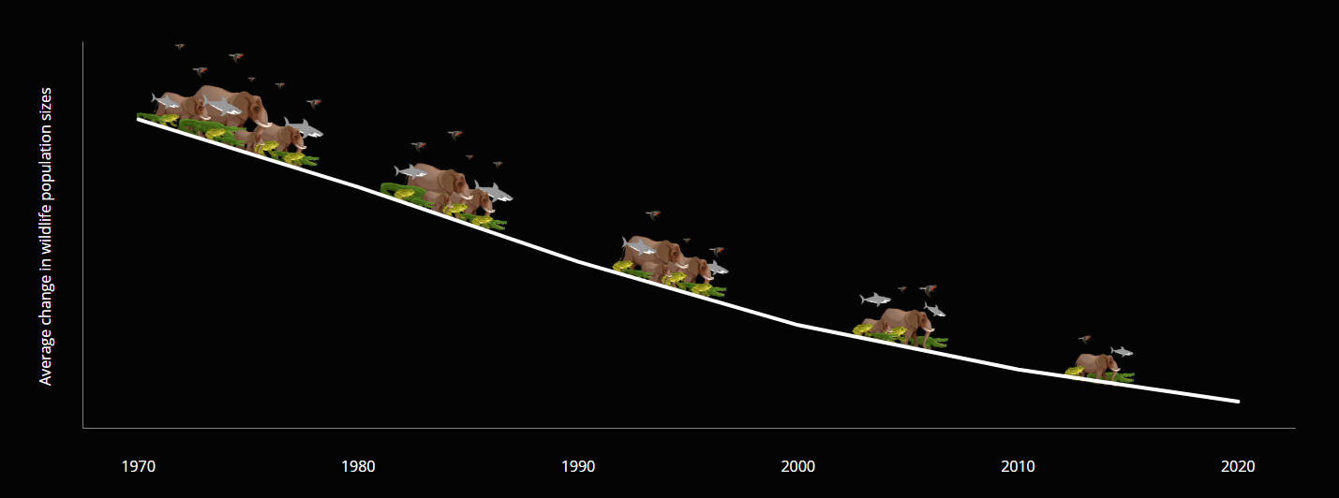
The 6th Mass Extinction is underway
Since 1970, global vertebrate biodiversity has sharply declined, with a 73% average drop in wild vertebrate populations(Living Planet Index, WWF 2022).

Slide 3
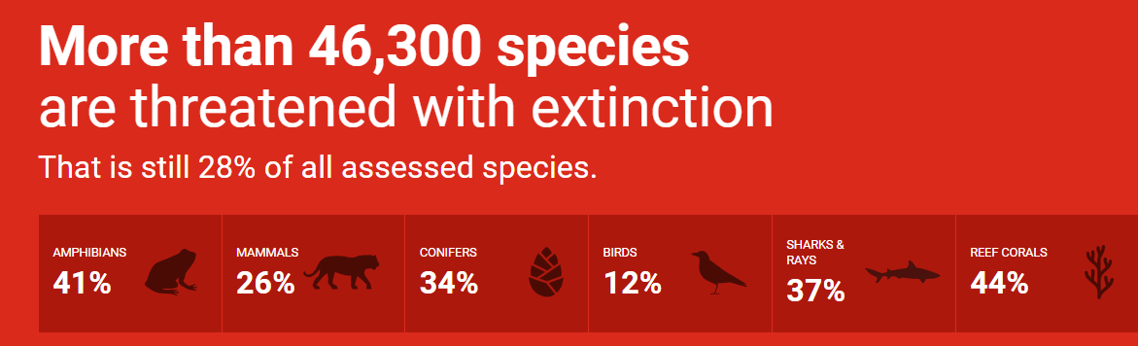
The IUCN Red List
The International Union for Conservation of Nature’s Red List of Threatened Species
41% of amphibian species are facing global threats
Critically Endangered, Endangered, and Vulnerable
https://www.iucnredlist.org/

Slide 4
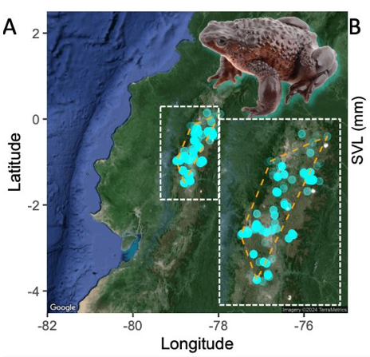

Atelopus ignescens (Jambato harlequin frog)
Ecuadorian Andes
1980s density: 10–50 individuals/m² (Black 1982; Almendáriz and Orcés 2004)
Declared extinct in 1988 (Coloma et al. 2000)
Rediscovered in 2016 by a school-age boy (Coloma 2016)
What caused their extinction?

Slide 5


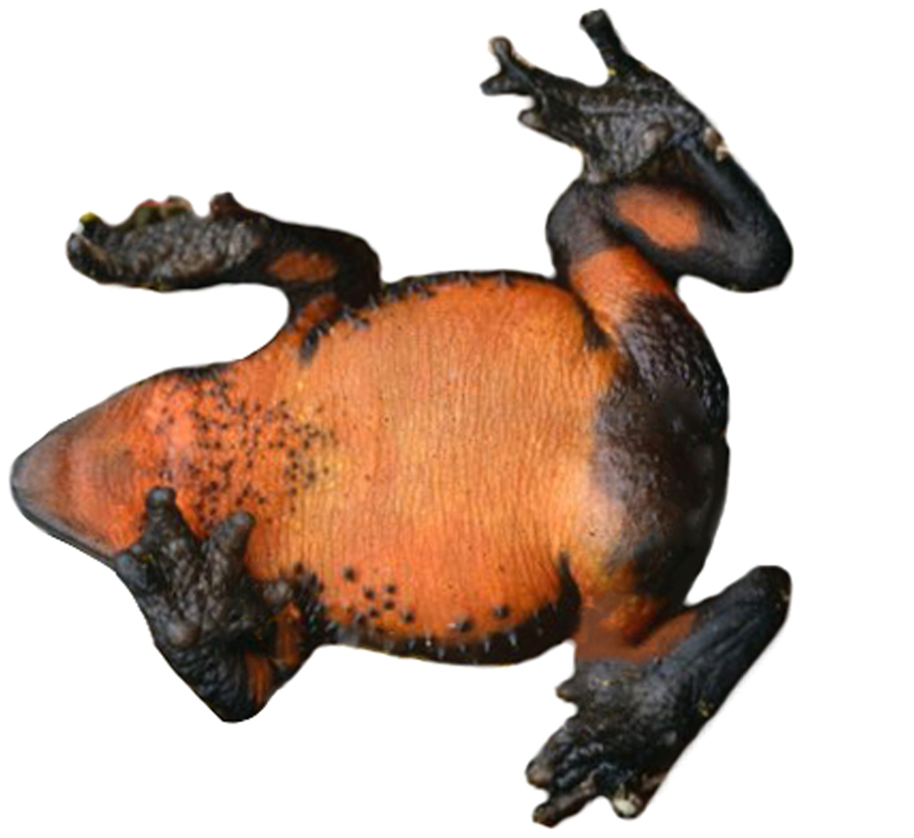
Main threat
[Literature]
Pathogens
The Batrachochytrium dendrobatidis (Bd) began to spread in the Andes in 1980
Climate Change
Temperature & precipitation patterns (drastic change after the 1970s)

Slide 6
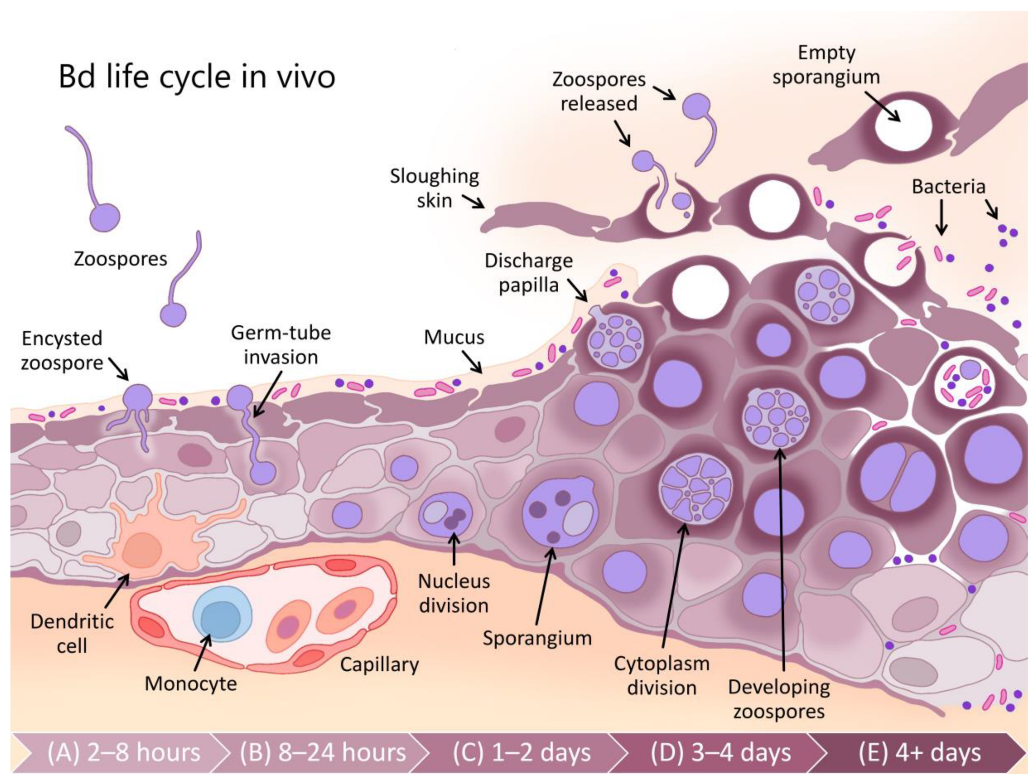
Batrachochytrium dendrobatidis (Bd)
Global amphibian declines and extinctions
Spreads via zoospores (swim in aquatic environments)
Invade skin, develop internally, release new zoospores causing secondary infections and transmission
Smith & Jones, 2020

Slide 7


Climate change in the Andes & worldwide

Slide 8
What is the extinct factor?
Hypotheses:
H1: Climate change since the 1970s has significantly reduced the suitable habitat range for Jambato harlequin frogs, leading to population collapse.
H2: The Bd fungal infection imposed selective pressure during its outbreak in the 1980s and triggered a population bottleneck.

Slide 9
Method
H1: Climate niche modeling
H2: directional selection on body size and mitochondrial population genetics before and after Bd epidemics.

Slide 10
Method: H1, Climate niche modeling
Climate
occurrence
Time
Species occurrence ~ climate I time

Slide 11
Records from the Global Biodiversity Information Facility (GBIF) and two museums (EPN and QCAZ)
Testing the impact of temperature and precipitation changes from 1960-2020 on the distribution of the Jambato harlequin frogs.
Generalized Linear Models (GLM) combined with climate data from each decade to model the distribution
*GLM: a regression statistical method that predicts relationships between the response and predicting variables.

Slide 12
Method
Mitochondrial DNA from 16 individuals collected in 1984 (the last pre-extinction samples)
Tajima’s D: A statistical measure to detect if a population has deviated from neutral evolution (e.g., undergone a rapid expansion or crash)
Negative values = Indicates an excess of rare alleles (e.g., mass die-off or selective event left only a few individuals to reproduce)
Positive values = Indicates a lack of rare alleles (long-term stable population size)

Slide 13
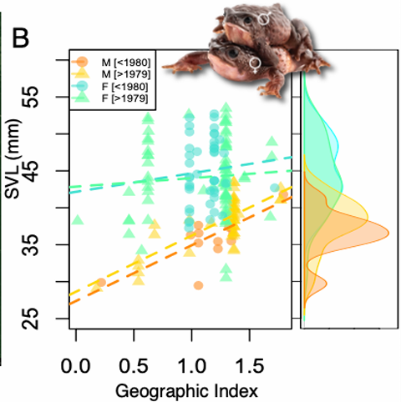
1.1 Survivor’s Trait
X axis: southwestern→ northeastern
Y-axis: snout-vent length
Male: spatial cline in body size
After Bd epidemic(>1979): Larger male size(only larger survived)
Female frogs: Still large, no significant change
Bd fungus: may imposed a strong selective pressure by killing smaller frogs

Slide 14
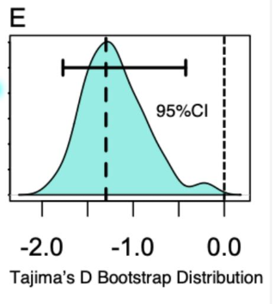
1.2 Tajima’s D
X axis: Tajima’s D value
Y-axis: Probability density of Tajima’s D value
Negative: Indicates an excess of rare alleles(a few individuals reproduce)
Bd may exert selective pressure on the population
Bd is not the only killer!

Slide 15
What is the extinct factor?
Hypothesis:
Climate change and changes in precipitation patterns since the 1970s have significantly reduced the suitable habitat range for the species, leading to population collapse.
The Bd fungal infection imposed selective pressure during its outbreak in the 1980s and triggered a population bottleneck. ⍻

Slide 16
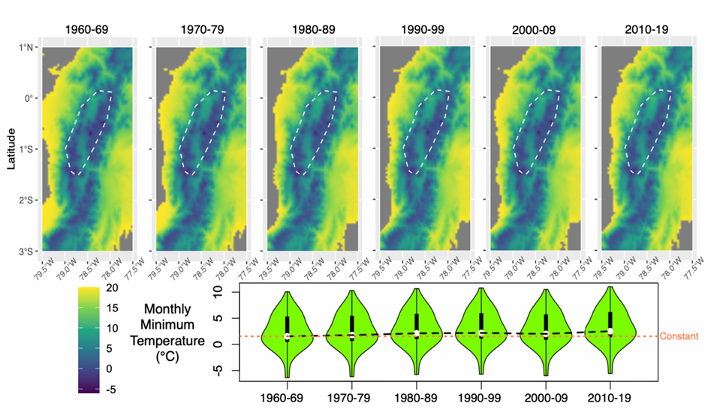
2.1 Annual Mean Monthly Minimum Temperature
Minimum Temperature: Annual mean ↑ significantly
Primary factor in habitat prediction
Bd Thermal Optimum: 17–25°C
Warmer → Bd transmission efficiency ↑

Slide 17
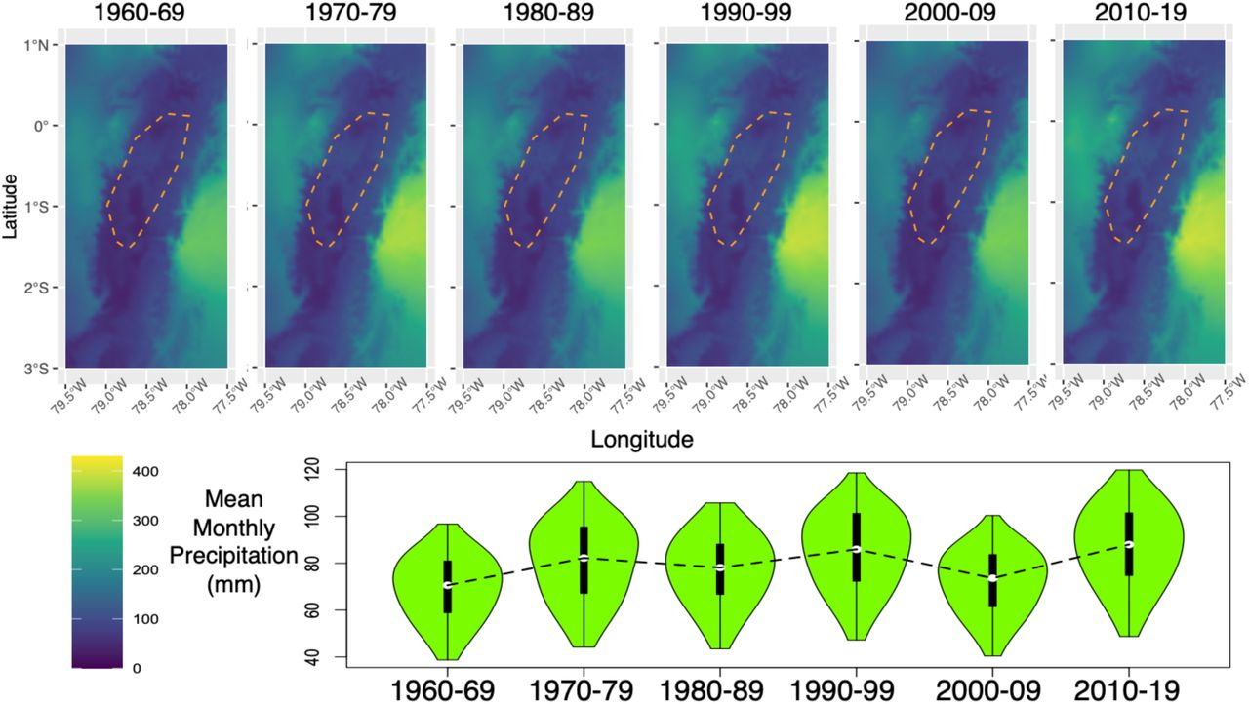
2.2 Decadal Trends in Annual Mean Monthly Precipitation
Precipitation patterns fluctuated across decades
Humid conditions → Bd fungal transmission ↑
Dry habitats → Shrinking water bodies → Bd transmission ↑

Slide 18
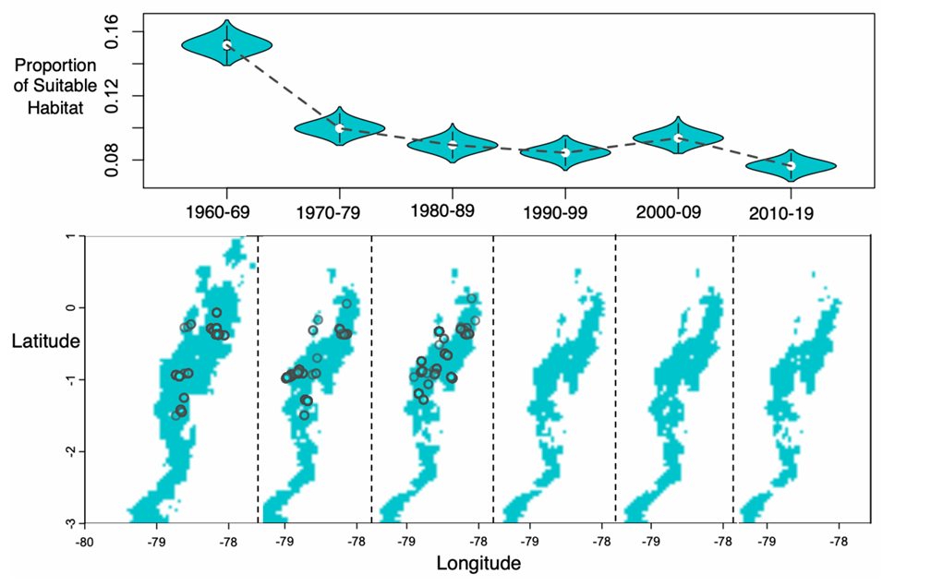
2.3 Predicted occurrence of Atelopus ignescens
Cyan-green areas: Suitable habitat predicted based on temperature and precipitation data
Black dots: historical records of species occurrences
By 2010–19, the predicted suitable habitat area had decreased by approximately 8,190 km²

Slide 19
What is the extinct factor?
Hypothesis:
Climate change and changes in precipitation patterns since the 1970s have significantly reduced the suitable habitat range for the species, leading to population collapse.✔
The Bd fungal infection imposed selective pressure during its outbreak in the 1980s and triggered a population bottleneck. ⍻

Slide 20

Conclusion
Global warming and precipitation fluctuations significantly accelerated habitat loss, likely contributing to population collapse

Slide 21
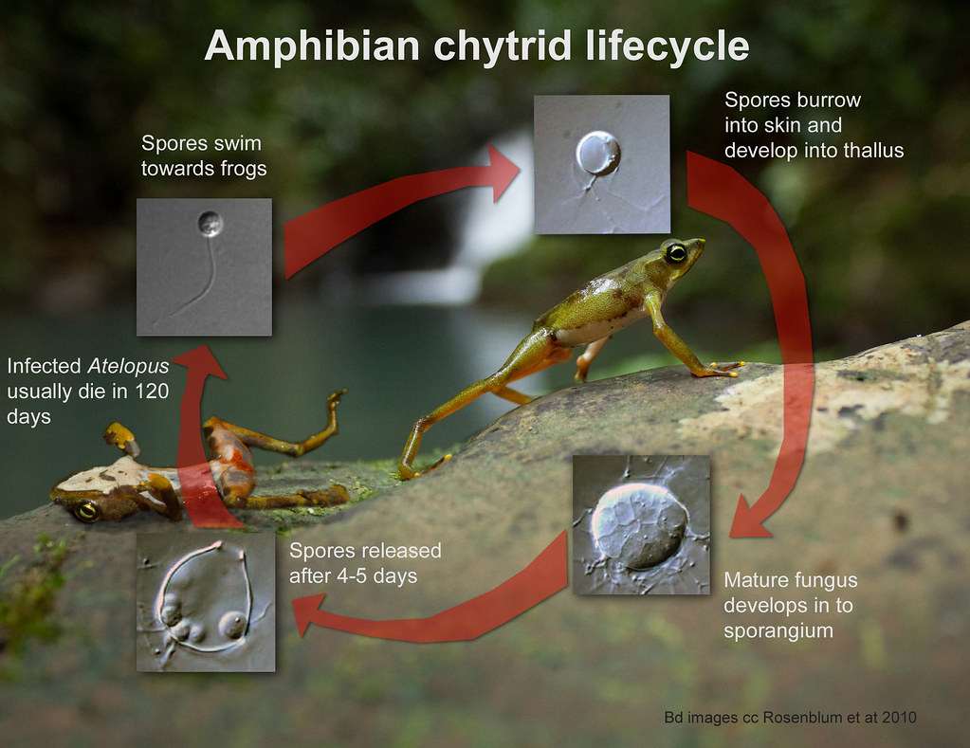
Conclusion
Bd infection may act as a catalyst in population collapse

Slide 22
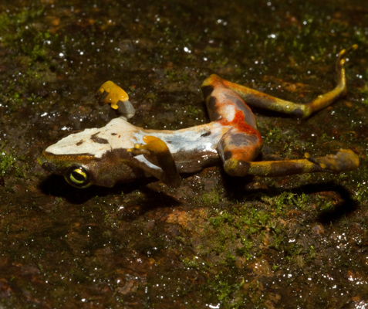
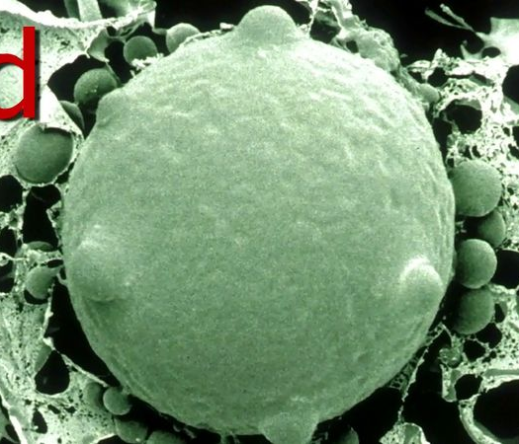
Conclusion
Synergistic Impact: Not one factor alone, the combination of habitat conditions and fungal epidemic best explains the observed extinction

Slide 23
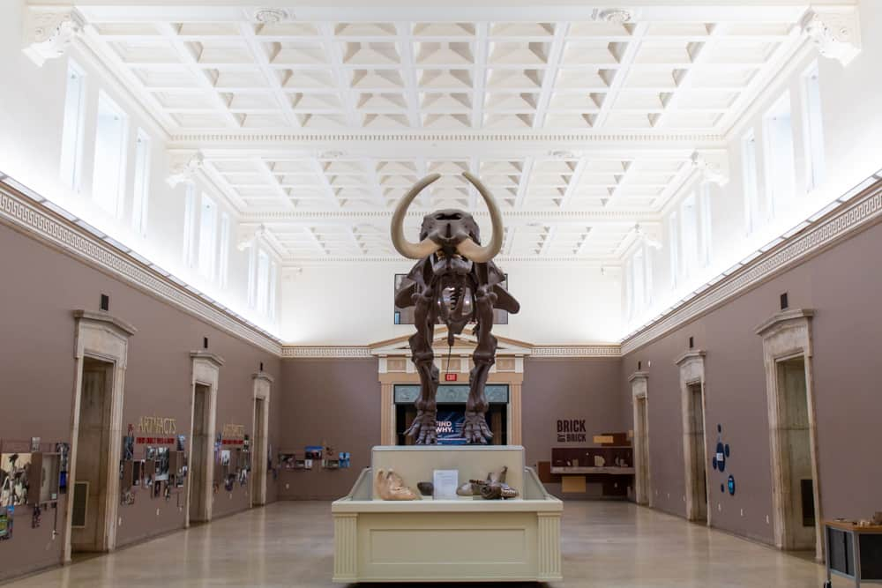
Research Significance
Museum Collection provide baseline data (past distributions, body sizes, DNA) enabled us to unravel the causes of decline

Slide 24

Research Significance
Be valuable for conservation, helping to identify possible causes of declines and guide future protection efforts

Slide 25
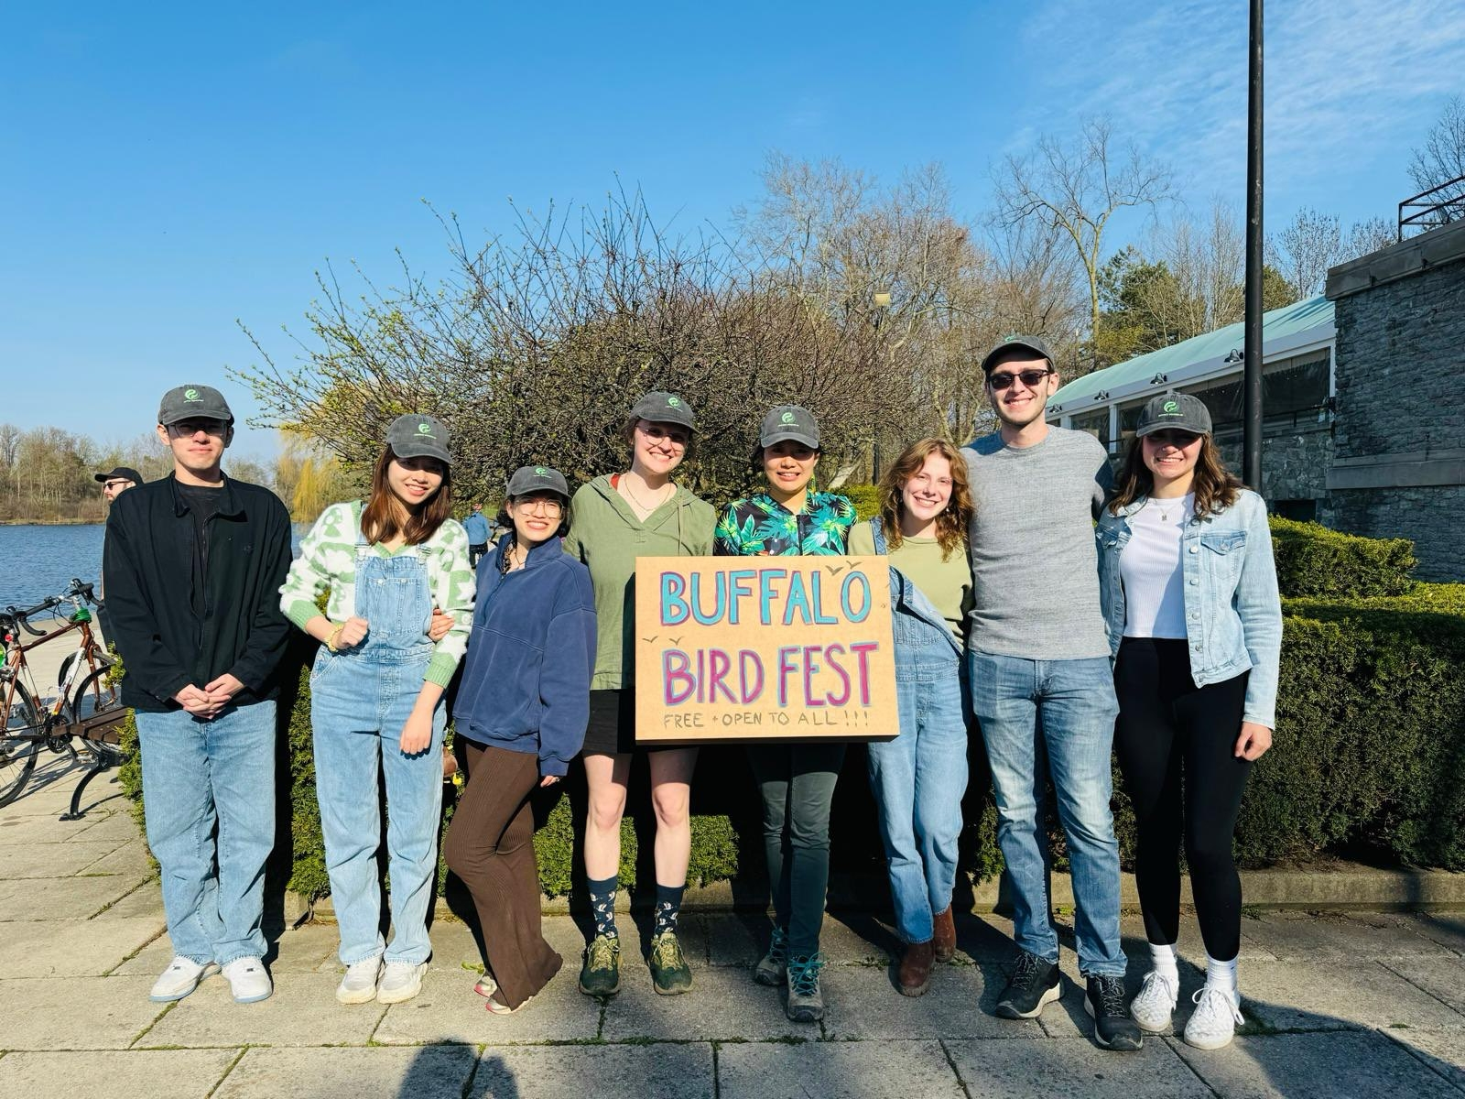
Thank you!
Advisor: Dr. Silu Wang
Comitte member: Dr. Samuel Crickenberger
Lab members:
Jozef O’Malley
Bailey Rouse
Derek Eddo
Julie Ann
Yinger Guo

